Slide 1
Senior Affairs Point of Sale System Memberships Training Course
Section 3
Issuing a New Membership Card
Revised December 13, 2016

Slide 2
DSA Memberships Course Section 3- Issuing a New DSA Membership Card
Overview:
A DSA Annual Membership is $13.00
A SAMS Registration application must be completed for every New and Renewal membership (Annually)
The SAMS System tracks transactions for Seniors 60+ for AAA Reporting Requirements
Memberships and benefits are issued based on age eligibility

Slide 3
DSA Memberships Course -Section 3 Issuing a New DSA Membership Card
There are Three Scenarios where you will issue a NEW DSA Membership Card:
New COA Member & New DSA Member:
Has never created a membership at Parks and Recreation or Department of Senior Affairs before.
Citizen does not have a City of Albuquerque Membership Account
Citizen is not in the Siriusware system. (Use Guest Lookup to Verify)
Has a COA Point of Sales system Membership Account that they started with Parks and Recreation, but is not a DSA member:
The member has a City of Albuquerque Membership Account
The member has or has had in the past, a Membership CARD/PASS from another department.
Member has a COA Membership Account in the Point of Sales system & has a DSA Membership that they want to renew, but have changed into a new age eligibility Class.
If a person has moved into a different eligible age class (e.g. turned 60), you will NOT process this as a renewal.
You will create a NEW membership pass with the member’s COA Membership Account information and print a new membership card in the appropriate eligibility class (Blue or Yellow Card). This ensures the correct membership card is printed and the appropriate benefits are provided to that specific member. (Note: A manager will need to merge the information. This is covered in a separate job aid).
Notes:
Age Group Change – e.g. when a person turns 60 and is renewing their membership, they will likely be holding the yellow card. They will need a new 60 plus blue card, therefore you will not process as a renewal in this case, you will process it as a new member 60+

Slide 4
DSA Memberships Course -Section 3 Issuing a New DSA Membership Card
Issuing a New DSA Membership Card
Scenario Overview: In this scenario, a citizen named Amy has come to your DSA Center and wants a DSA Membership.

Slide 5
DSA Memberships Course -Section 3 Issuing a New DSA Membership Card
Step 1
STEP ONE – Guest Lookup
First, ALWAYS check if the person is in the Siriusware system by clicking the Guest Lookup button and using the information from their SAMS registration form.
If they are NOT in the system, you will create a new membership.
If they ARE in the system you will need to see what membership CARDS/PASSES they have and determine if the transaction will be a renewal or a new membership.

Slide 6
To begin a search for a guest in the system, click the “Guest Lookup” button.

Slide 7
DSA Memberships Course -Section 3 Issuing a New DSA Membership Card
If, after looking in the guest lookup, you find that Amy is NOT in the System, you will create a membership account and issue a Senior Affairs Membership Card.
Follow the next screens/steps to learn how to:
Create a new City of Albuquerque Member Account
Issue a DSA Membership Card

Slide 8
DSA Memberships Course -Section 3 Issuing a New DSA Membership Card
Step 2
To begin a new Membership, click the “Membership” button.

Slide 9
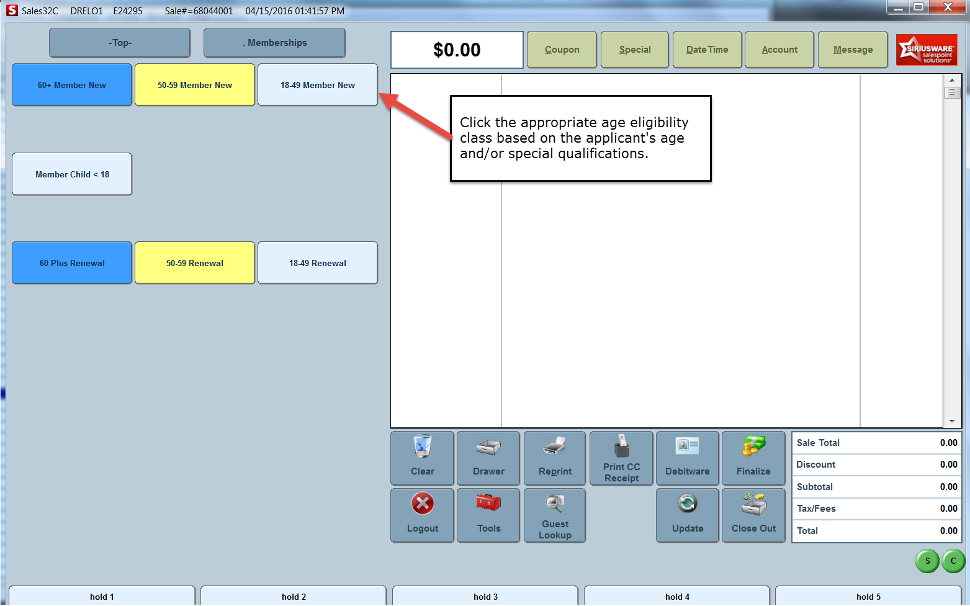
DSA Memberships Course -Section 3 Issuing a New DSA Membership Card
Step 3
Click the appropriate age eligibility class based on the applicant’s age and/or special qualifications

Slide 10
DSA Memberships Course -Section 3 Issuing a New DSA Membership Card
Step 4
Enter guest information into the appropriate fields and take the Member’s Photo:
First and Last Name
Date of Birth
Address
Zip Code
Phone Number

Slide 11
Step 4
A
B

Slide 12
DSA Memberships Course -Section 3 Issuing a New DSA Membership Card
Step 5
Click “Freeze” to take a new picture.

Slide 13
DSA Memberships Course -Section 3 Issuing a New DSA Membership Card
Step 6
Click on the image area to resize/crop and then click the “crop and Save” button to save the member’s picture
Tip: Reposition/resize the crop if necessary and click save.

Slide 14
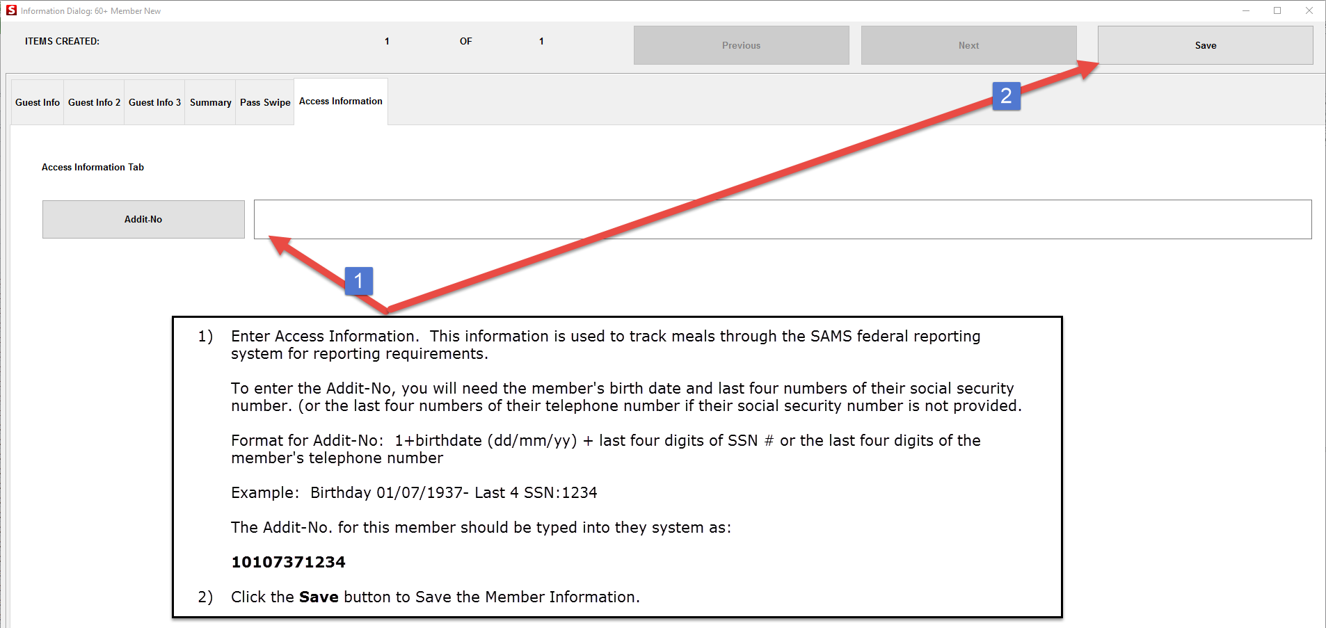
DSA Memberships Course -Section 3 Issuing a New DSA Membership Card
To finish, click Save>Finalize (All information entered will be saved)
Guest Number: A guest number is automatically assigned by the Point of Sale System when you enter and save the information in the system.
B
A
A
B

Slide 15
DSA Memberships Course -Section 3 Issuing a New DSA Membership Card
Step 7
Process Payment & Print Membership Card
If paying with a card, slide the card through the card reader on the Siriusware screen and once the payment is processed, the membership card will print.
If paying with cash click the “Finalize” Button. Once the payment is processed, the membership card will print

Slide 16
DSA Memberships Course -Section 3 Issuing a New DSA Membership Card
Congratulations! You have gone through the steps required to create a New City of Albuquerque Member Account and issue a Department of Senior Affairs Membership Card.

Slide 17
DSA Memberships Course -Section 3 Issuing a New DSA Membership Card
You will now learn how to issue a DSA membership card to a person who already has an account in the Point of Sales system.
In this scenario, a citizen has already obtained a City of Albuquerque Member Account and Golf Membership at a Golf site and arrives at your Center to obtain a Senior Affairs Membership.

Slide 18
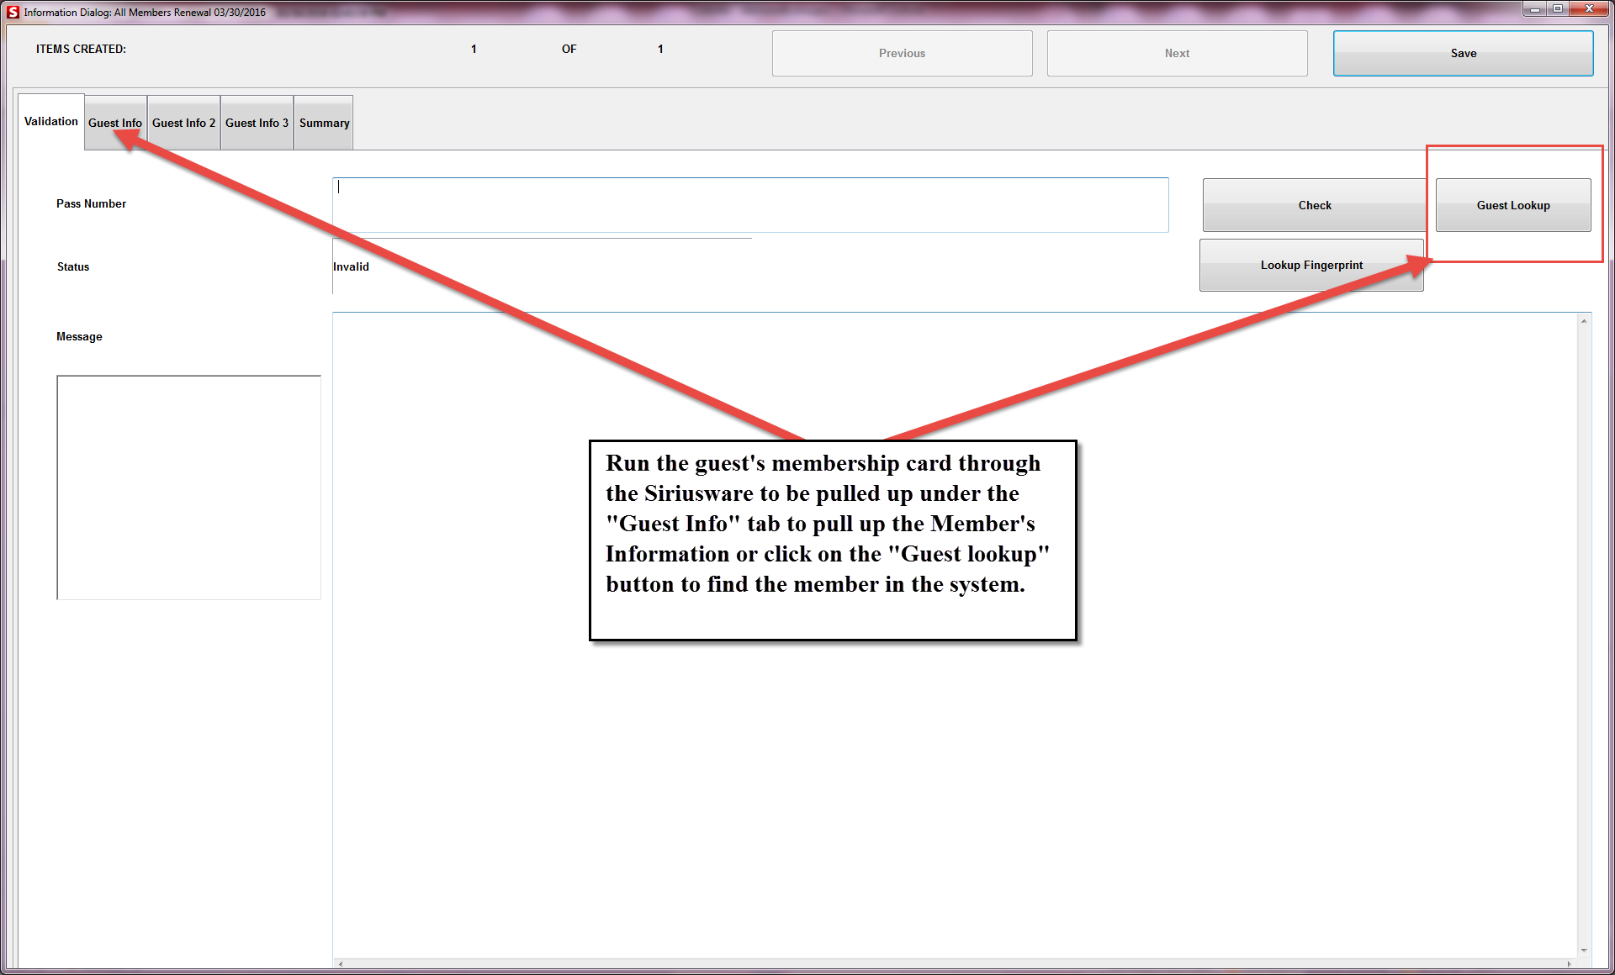
DSA Memberships Course -Section 3 Issuing a New DSA Membership Card
Senior Center:
Look up the citizen by clicking on the Guest lookup button to see if they are already in the system.
Run the guest’s membership card through the Siriusware system to be pulled up under the “Guest Info” tab to pull up the member’s information or click on the “Guest Lookup” button to find the member in the system.

Slide 19
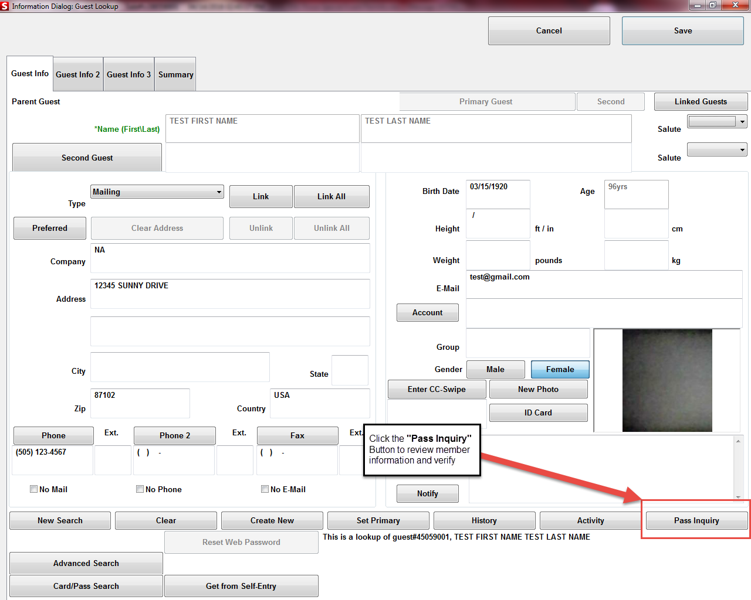
DSA Memberships Course -Section 3 Issuing a New DSA Membership Card
Check the passes that the citizen holds

Slide 20
DSA Memberships Course -Section 3 Issuing a New DSA Membership Card
If the citizen does not have a membership issued through DSA, have them complete the Membership/SAMS form.
When they are done filling out the SAMS form, to begin their Membership, you will do a guest lookup search in the system to see if they are in the system.
Because the citizen opened a membership at a golf center, he does have an account and his basic information is in the Point of Sale System.
You still need to make sure that the citizen’s information is correct by asking for his first and last name, his Date of Birth and his address or refer to the SAMS registration form provided.
Make sure that the citizen’s picture is them.

Slide 21
DSA Memberships Course -Section 3 Issuing a New DSA Membership Card
Once the citizen fills out their form and pays the $13.00 fee, you will issue a Membership Card to them.
You will also need to enter the citizen’s information into the SAMS system.

Slide 22
DSA Memberships Course -Section 3 Issuing a New DSA Membership Card
Test Printed Card: Test the Printed card in both the Siriusware and SAMS system card swipe readers to ensure the card works and pulls up the member’s information.
Reprint Card: If the card did not print correctly, do a reprint and test.
Expiration Date Label: Adhere the new Expiration Date Label to the back of the member’s card and write the new expiration date on the label.
Note: Ensure that the label does not cover or is not near the magnetic stripe as this could potentially cause issues with the scanner.

Slide 23
DSA Memberships Course -Section 3 Issuing a New DSA Membership Card
Citizen now has two Membership cards, one for Golf and one for Senior affairs, but only has one City of Albuquerque Member Account in the Point of Sales system.

Slide 24
DSA Memberships Course -Section 3 Issuing a New DSA Membership Card
Congratulations! You have completed Section 3- Issuing a New DSA Membership Card for the DSA Point of Sale Memberships Course

